Slide 1
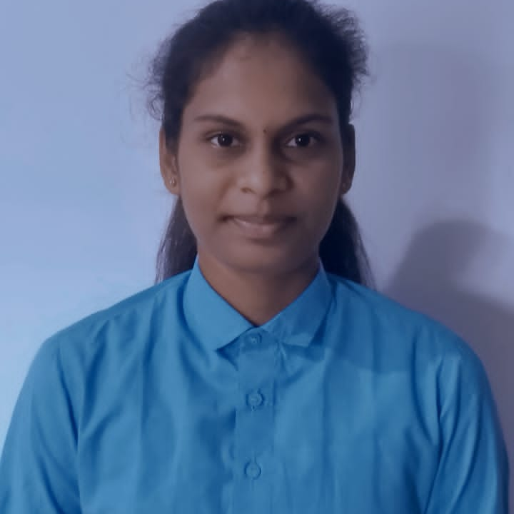



Jyoshna
Analyst/Software Engineer
Bachelor of Engineering
Computer Science : 2016 - 2020
Skills
BANGALURU
Java 8 /J2EE | Java Basics, OOPS, Generics, Collections, Arrays, Loops, Lambda Exp, Stream API Junit, Mockito, Servlets
Spring core | IOC & Dependency Injection, Autowire
Spring REST | REST controllers, Implementation of GET, POST, PUT & DELETE, Bean Validation & Exception Handling, Testing Services, Controller & Repository layer
Spring Data JPA | Implement DAO layer using spring Data repositories, Transaction Management
Spring Boot Microservices | Spring Boot Starters, annotations, Messaging Service, Sync/Async comms, Swagger API specifications
Spring Cloud | Eureka, Hystrix, & Config Server
React | Components, Hooks, Event handling, Redux, Reducers,
Database | MongoDB No Sql Advanced My SQL RDS Basics
UI Tech | HTML 5 & CSS 3,JavaScript, ES6 & TypeScript Reusable templates, Optimized UI Designed
Tools | Git, Postman, Maven
REDDEM.JYOSHNA@CAPGEMINI.COM
+91 6304057515
MERN (Mongo, React, spring) developer
Hands on experience in developing web pages using HTML5, CSS3, Object Oriented Java script, ES6, JSON, XML. Good understanding of Document Object Model (DOM) and DOM Functions.
Practical understanding of advanced Javascript concepts, such as Prototype, Closure, Scope Chain and Promise.
Proficient React developer with working knowledge on ReactJS(Hooks, redux).
Java Microservice Development knowledge using Spring boot and spring cloud framework on an intermediate level.
Implemented Nodejs in case study and upskilling his knowledge continuously.
Experienced in practicing TDD based development using tools like Mockito, Junit, Istanbul and ensuring quality
Flight-booking system
Completed end to end case study of Shopping Cart Application along with JWT authentication, Swagger loggers and payment in MERN Stack. Material-UI and React Bootstrap used for user interface.
FULL STACK DEVLOPMENT at udemy
HTML CSS BOOTSTRAP JAVASCRIPT is completed using this I create a responsive website(tindog,drumstick)
Check out my work on GitHub & Video Profile

